Slide 1

8th Grade Math: Pre-Algebra
Unit 4, Lesson 11 Applying Multiple Laws of Exponents – Part 2 Volume 1, pg. 170

Slide 2


Benchmark
MA.8.AR.1.1
Apply the Laws of Exponents to generate equivalent algebraic expressions, limited to integer exponents and monomial bases.
volume 1, pg. 170

Slide 3
Integrated Mathematical Thinking and Reasoning Standards
MA.K12.MTR.1.1 Actively participate in effortful learning both individually and collectively.
MA.K12.MTR.4.1 Engage in discussions that reflect on the mathematical thinking of self and others.
volume 1, pg. 170

Slide 4

Learning Target
I can write an equivalent algebraic expression by applying multiple laws of exponents.
volume 1, pg. 170

Slide 5

Warm-Up
volume 1, pg. 170

Slide 6
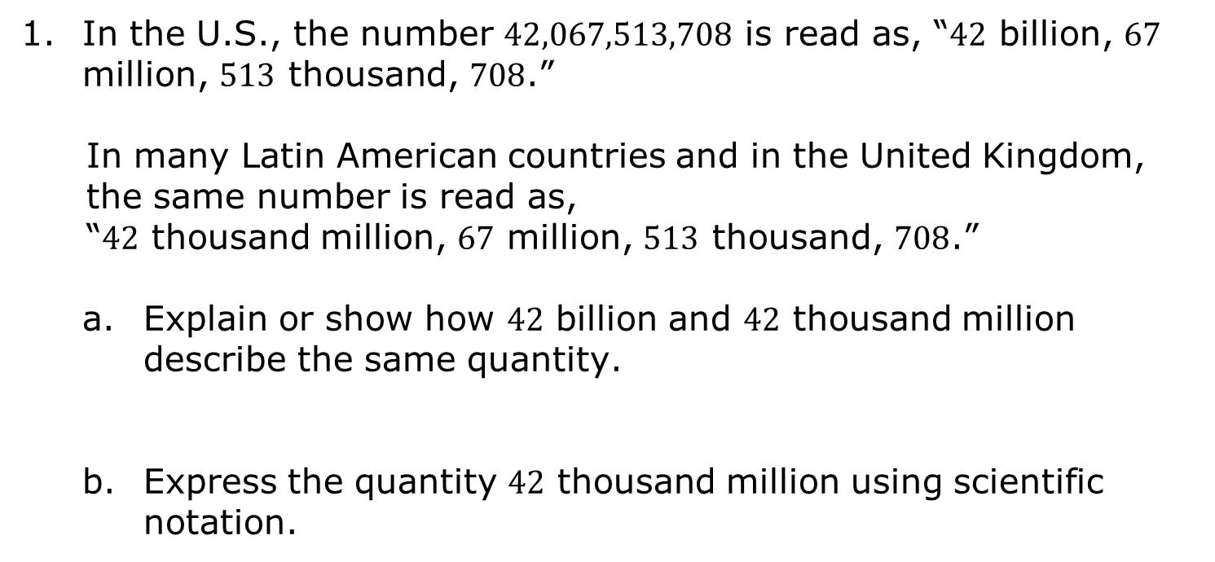
4.11.1 Warm-Up: Reading Numbers
In the U.S., the number $42,067,513,708$ is read as, “$42$ billion, $67$ million, $513$ thousand, $708$.”
In many Latin American countries and in the United Kingdom, the same number is read as,
“$42$ thousand million, $67$ million, $513$ thousand, $708$.”
Explain or show how $42$ billion and $42$ thousand million describe the same quantity.
Express the quantity $42$ thousand million using scientific notation.
volume 1, pg. 170
Notes:
Video Link: https://algebranation.wistia.com/medias/fi4fidi5y8

Slide 7

Activity
volume 1, pg. 171

Slide 8
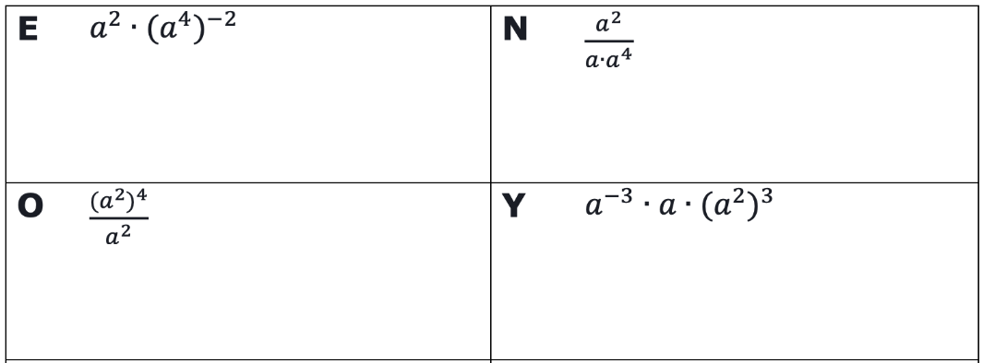
4.11.2 Activity: Riddle Me This
Work with your partner to generate equivalent expressions for each expression given below by applying the laws of exponents. Your results will be used to complete the riddle in question 2.
volume 1, pg. 171

Slide 9
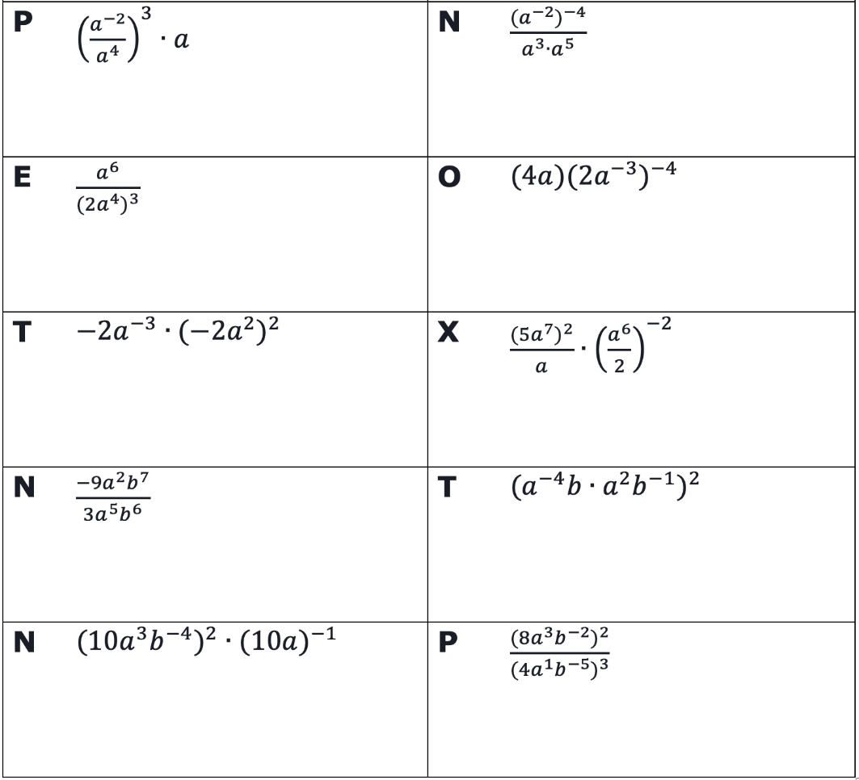
volume 1, pg. 171

Slide 10
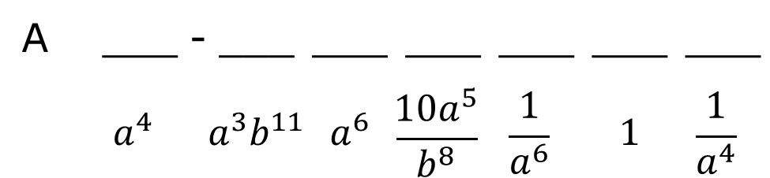
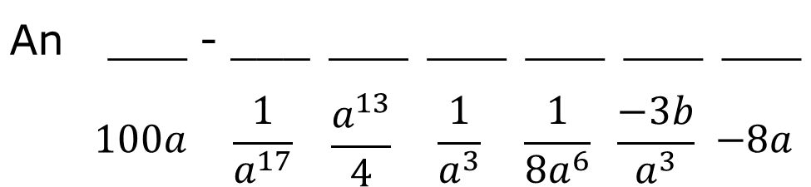
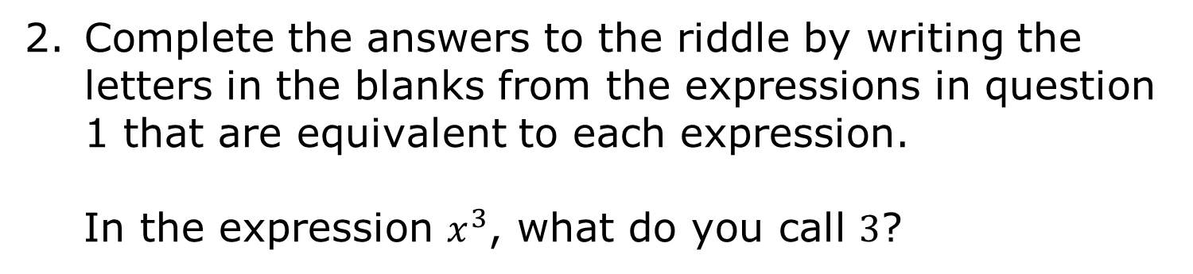
Complete the answers to the riddle by writing the letters in the blanks from the expressions in question 1 that are equivalent to each expression.
In the expression $x^{3}$, what do you call $3$?
An |  | ___ | - | ___ | ___ | ___ | ___ | ___ | ___
 |  | $$100a$$ |  | $$\frac{1}{a^{17}}$$ | $$\frac{a^{13}}{4}$$ | $$\frac{1}{a^{3}}$$ | $$\frac{1}{{8a}^{6}}$$ | $$\frac{−3b}{a^{3}}$$ | $$−8a$$
In the expression $y^{2}$, what do you call $2$?
A |  | ___ | - | ___ | ___ | ___ | ___ | ___ | ___
 |  | $$a^{4}$$ |  | $a^{3}b^{11}$ | $a^{6}$ | $$\frac{10a^{5}}{b^{8}}$$ | $$\frac{1}{a^{6}}$$ | $1$ | $$\frac{1}{a^{4}}$$
volume 1, pg. 171

Slide 11
Activity
volume 1, pg. 172

Slide 12
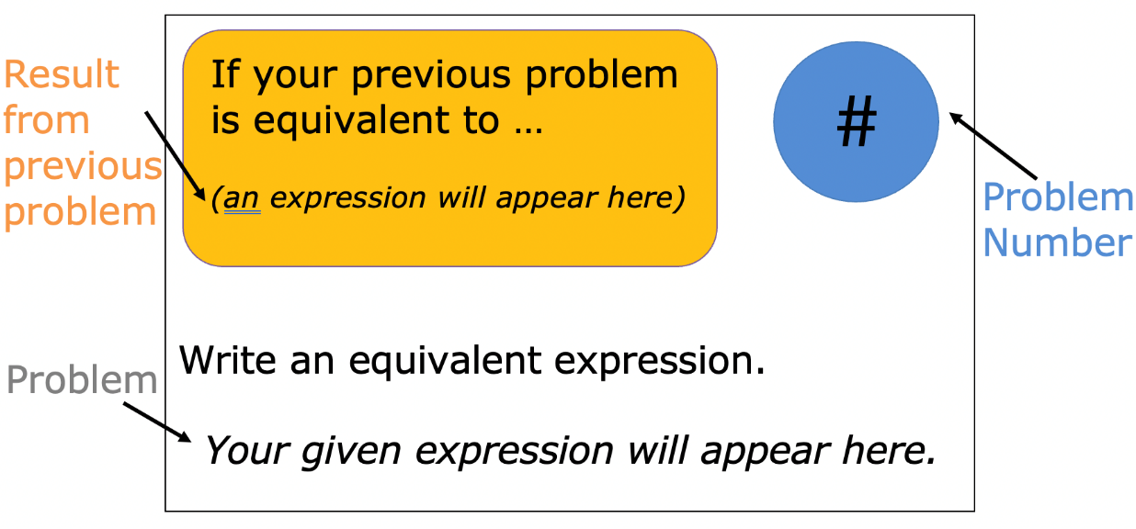
4.11.3 Activity: Scavenger Hunt
Work with your partner or group to complete the scavenger hunt. Each card in the scavenger hunt appears as shown.
volume 1, pg. 172

Slide 13
Write the number of the problem you start with and the given expression in the first row of the table. Then, work with your group or partner to generate an equivalent expression using the fewest number of factors.
Look for the card with an expression equivalent to your problem to find your next problem to work on.
Repeat this process until your group has completed all the scavenger hunt problems and have ended up back at your original problem.
volume 1, pg. 172

Slide 14
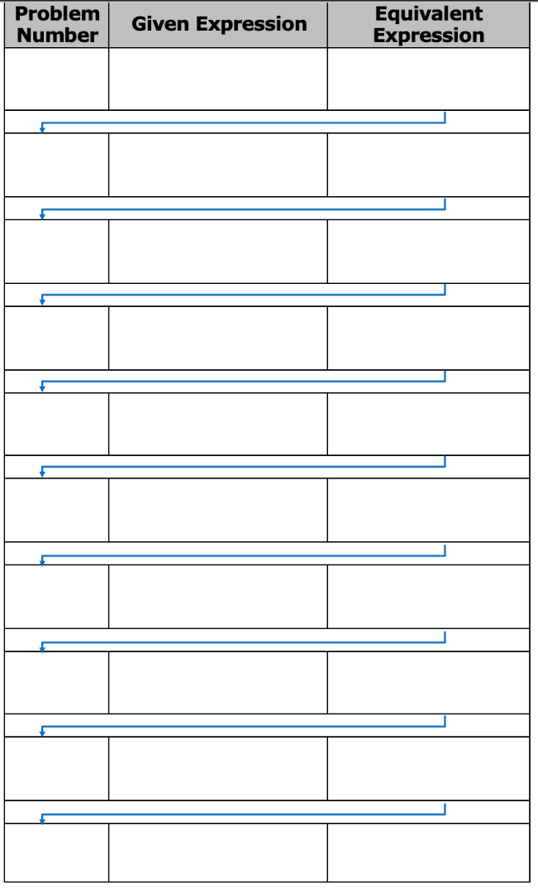
volume 1, pg. 172

Slide 15

Wrap-Up
volume 1, pg. 173

Slide 16



4.11.4 Wrap-Up: Reflection
Circle the icon that best describes your understanding of each learning target in the table.
I need help. I got it. I could help someone.
Apply one law of exponents to generate an equivalent algebraic expression
Apply multiple laws of exponents to generate an equivalent algebraic expression
Determine if two algebraic expressions are equivalent
volume 1, pg. 173

